Slide 1

Deep Learning for Object Tracking
Shobhit
19CS06008
Under the Guidance:
Dr. Debi Prosad Dogra

Slide 2
Contents
Introduction
Types of Object Tracking
Challenges of Object Tracking
Framework of Object Tracking
Dataset Information
DeepSort – Method 1 (Online Tracking)
STAM-MOT – Method 2 (Online Tracking)
AMIR – Method 3 (Online Tracking)
SiameseCNN – Method 4 (Offline Tracking)
Conclusion

Slide 3
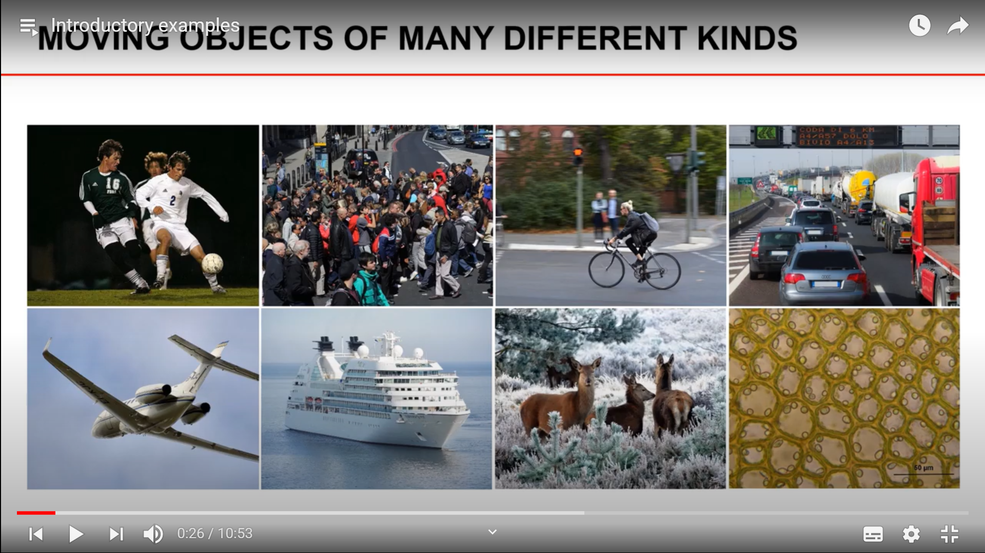
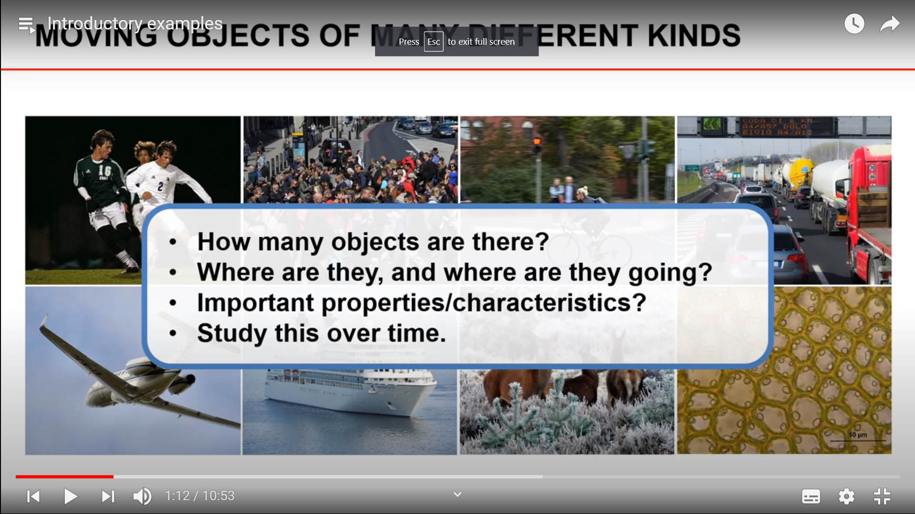
Introduction

Slide 4
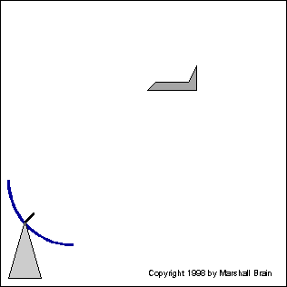

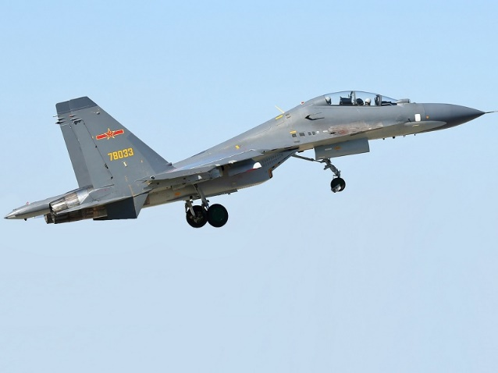
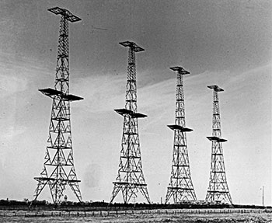

Introduction

Slide 5
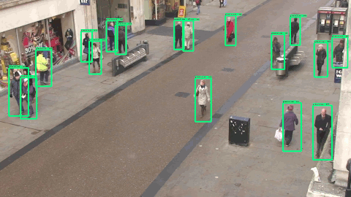
Introduction

Slide 6
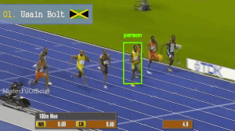
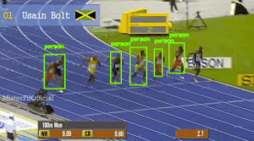
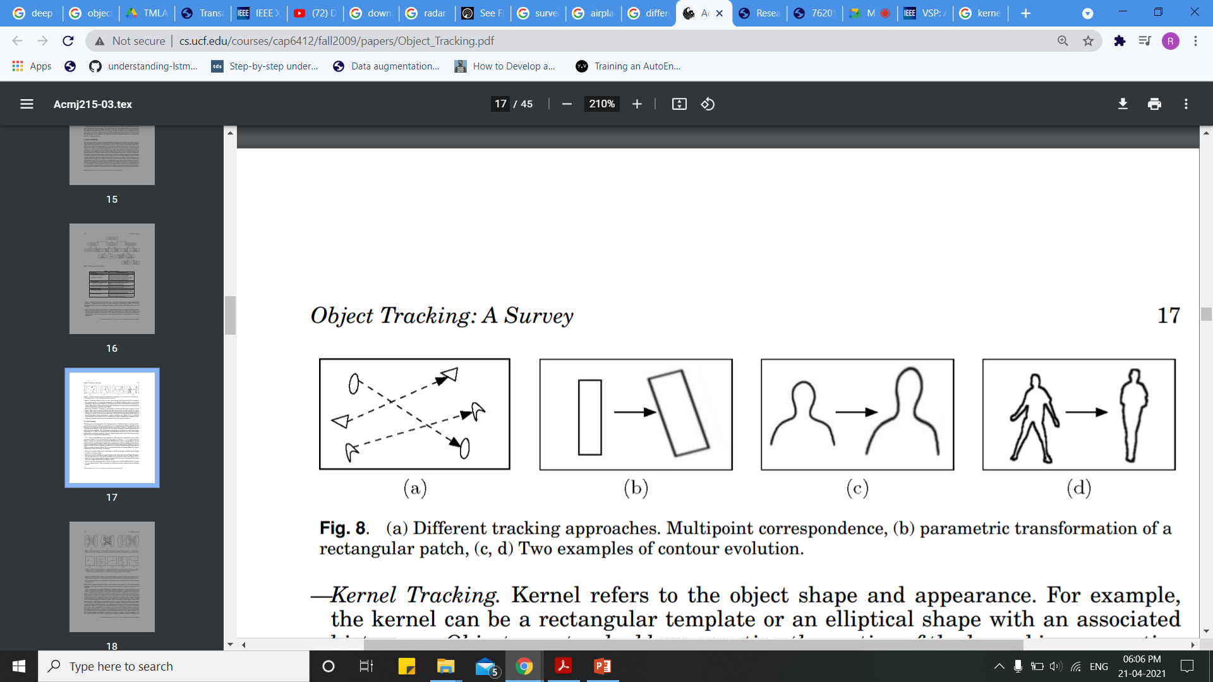
Types of Object Tracking
Single Object Tracking
Multiple object Tracking
Online Tracking
Offline Tracking
Point Tracking
Kernel Tracking
Silhouette Tracking

Slide 7

Challenges in Object Tracking
Frequent Occlusions
Initialization and Termination of Tracks
Similar Appearances
Interaction among other Objects
Low Resolution
Motion Blur

Slide 8
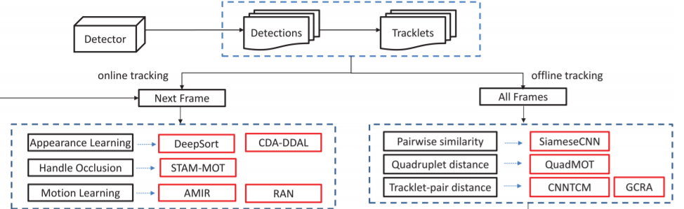
Framework of Object Tracking
Chen, Shengyong & Xu, Yingkun & Zhou, Xiaolong & Li, Fenfen. (2019). Deep Learning for Multiple Object Tracking: A Survey. IET Computer Vision. 13. 10.1049/iet-cvi.2018.5598.

Slide 9
Dataset Information
MOT15
Train : 11 Videos
Test : 11 Videos
Total Length : 389 sec
Total Object Tracks : 500
Types : Outdoor Videos
MOT16
Train : 7 Videos
Test : 7 Videos
Total Length : 215 sec
Total Object Tracks : 517
Types : Outdoor Videos

Slide 10
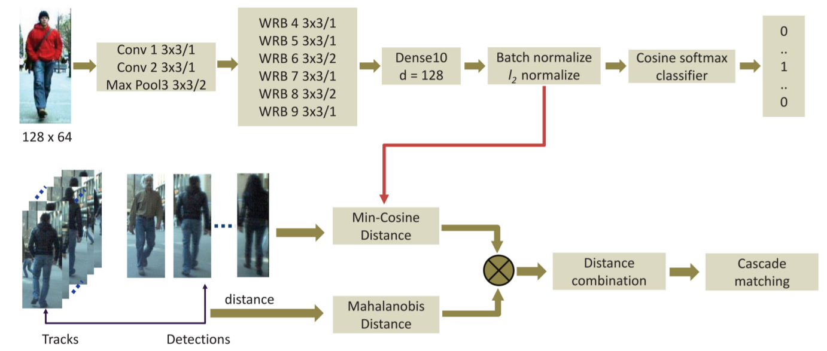
DeepSort
Wojke, N., Bewley, A., Paulus, D.: ‘Simple online and realtime tracking with a deep association metric’. Proc. Int. Conf. on Image Processing, Beijing, China, 2017, pp. 3645–3649

Slide 11
Dataset Used:
MOT16
Pros:
Extension of SORT that can track objects for longer period of occlusions.
Reduces the number of identity switches.
Generation of stable and stationary tracks.
Cons:
Does not perform well on static scenes and gives false positives when inspected visually.
Wojke, N., Bewley, A., Paulus, D.: ‘Simple online and realtime tracking with a deep association metric’. Proc. Int. Conf. on Image Processing, Beijing, China, 2017, pp. 3645–3649

Slide 12
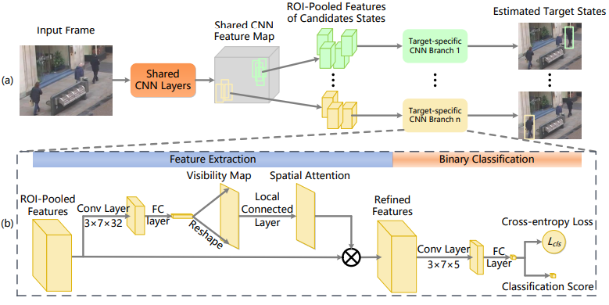
Spatial Temporal Attention Mechanism-Multiple Object Tracking (STAM-MOT)
Chu, Q., Ouyang, W., Li, H., et al.: ‘Online multi-object tracking using CNNbased single object tracker with spatial-temporal attention mechanism’. Proc. IEEE Int. Conf. Computer Vision, Venice, Italy, 2017, pp. 4846–4855

Slide 13
Dataset Used:
MOT15
MOT16
Pros:
Shares computation of single object to multiple objects making computational effective.
Usage of Visibility Map helps to handle occlusion.
Gives the status of occlusion.
Cons:
Many ROI-Pooled Features are generated.
Fails when there is a severe camera motion fluctuation.
Chu, Q., Ouyang, W., Li, H., et al.: ‘Online multi-object tracking using CNNbased single object tracker with spatial-temporal attention mechanism’. Proc. IEEE Int. Conf. Computer Vision, Venice, Italy, 2017, pp. 4846–4855

Slide 14
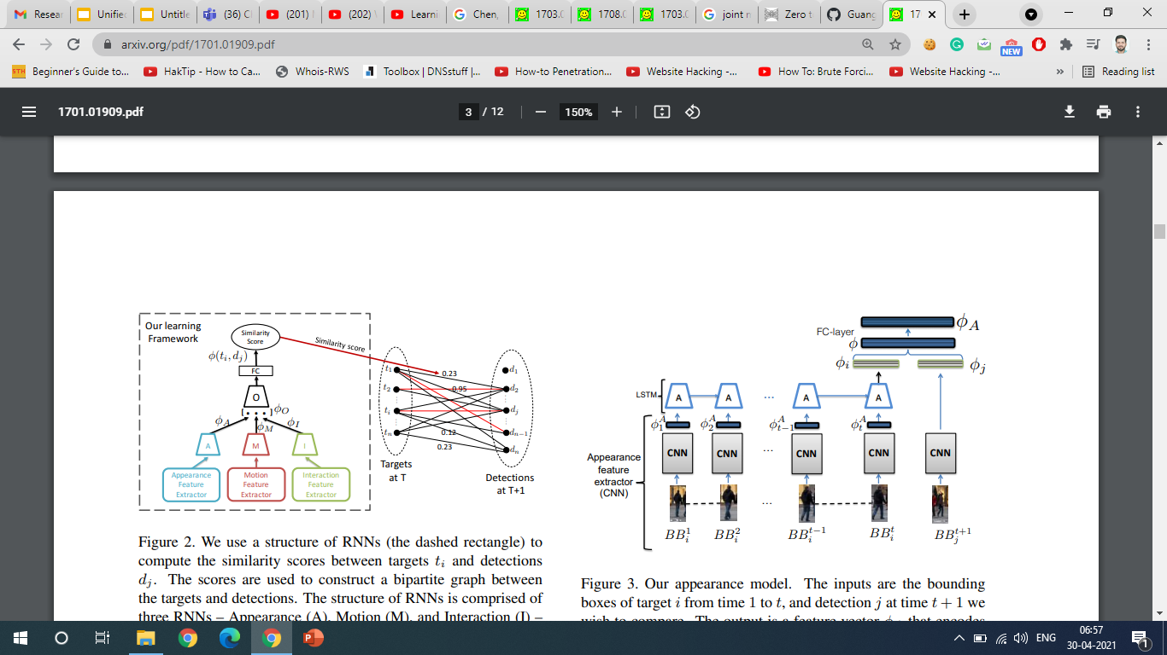
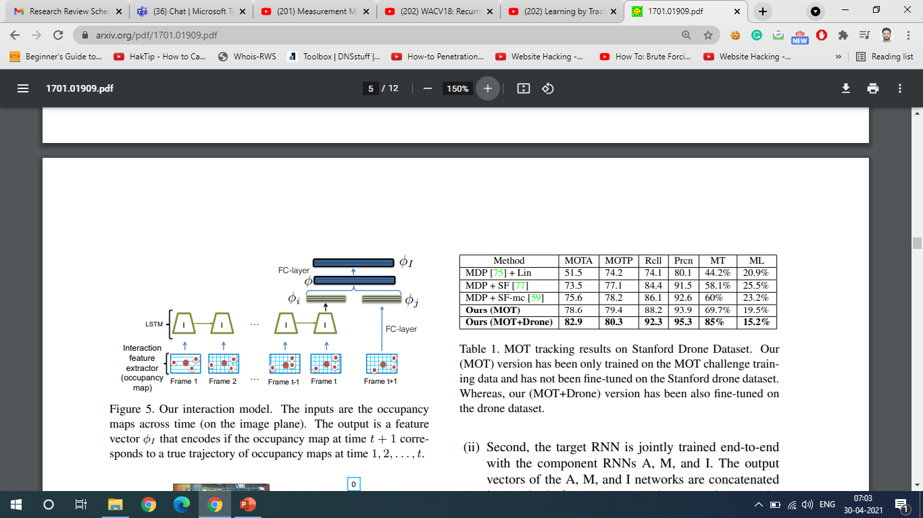
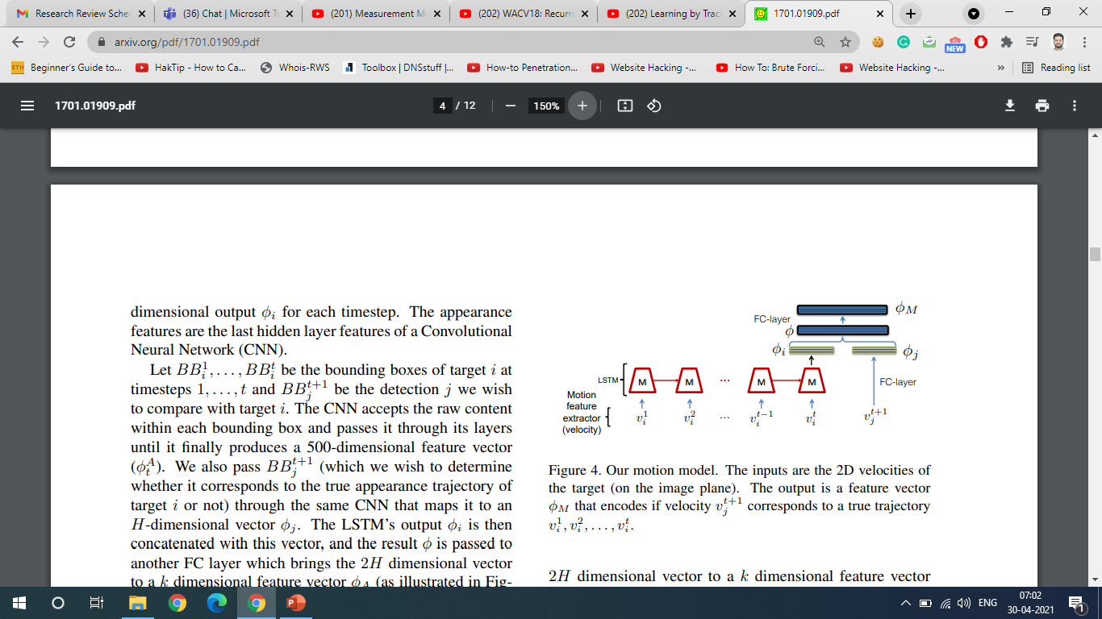
AMIR
Sadeghian, A., Alahi, A., Savarese, S.: ‘Tracking the untrackable: learning to track multiple cues with long-term dependencies’. Proc. IEEE Int. Conf. Computer Vision, Venice, Italy, 2017, pp. 300–311

Slide 15
Dataset Used:
MOT 15
MOT 16
Pros:
Simpler and Effective method for handling occlusions.
Modular architecture help increase the accuracy.
Cons:
Works only for human based data.
Computationally expensive due to recalculation of targets and detections.
Sadeghian, A., Alahi, A., Savarese, S.: ‘Tracking the untrackable: learning to track multiple cues with long-term dependencies’. Proc. IEEE Int. Conf. Computer Vision, Venice, Italy, 2017, pp. 300–311

Slide 16
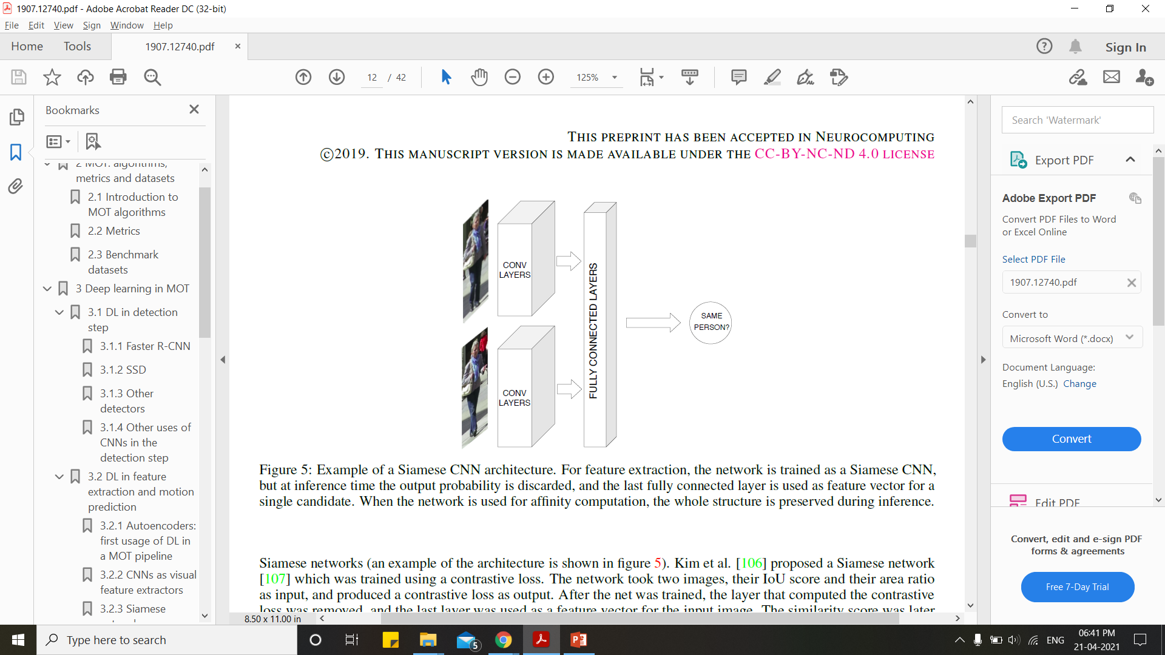
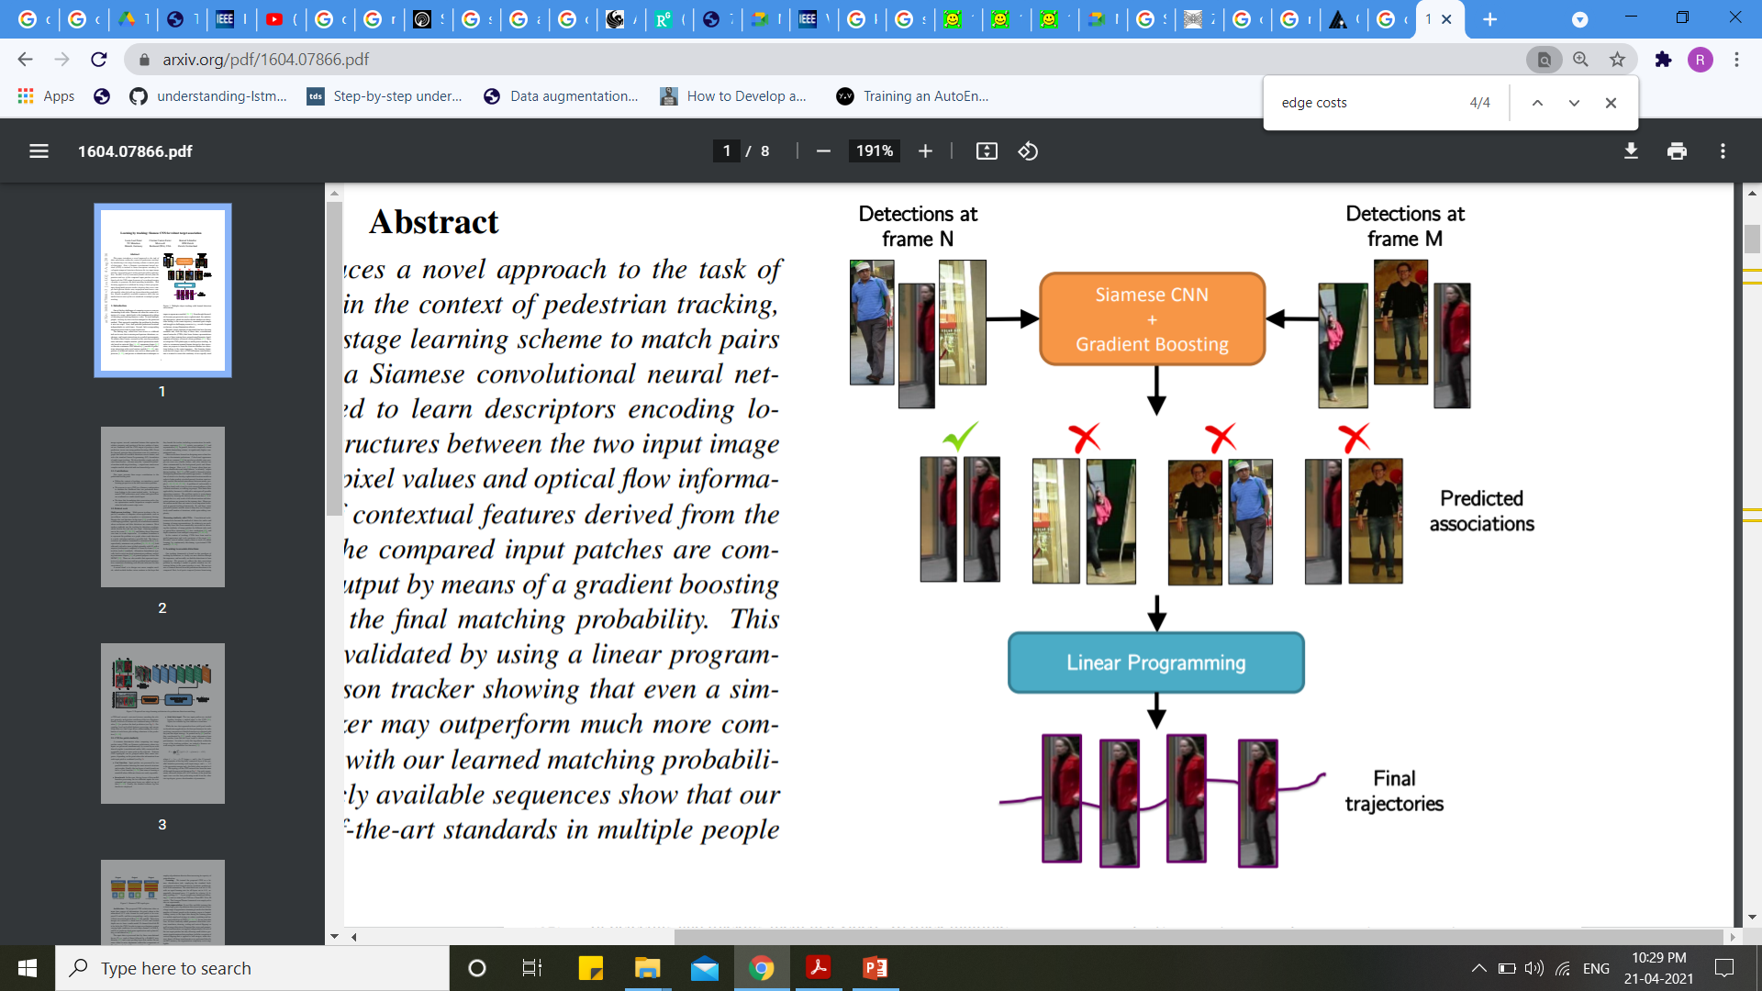
SiameseCNN
L. Leal-Taixe, C. Canton-Ferrer, and K. Schindler. Learning ´ by tracking: Siamese cnn for robust target association. In CVPRW, 2016.

Slide 17
Dataset Used:
MOT15
Pros:
Pixel values and optical flow are used for better accuracy in detection phase.
Trajectories of the object are determined accurately.
Cons:
Offline Tracking and thus cannot be used in Real Time Systems.
Works only for pedestrian tracking.
L. Leal-Taixe, C. Canton-Ferrer, and K. Schindler. Learning ´ by tracking: Siamese cnn for robust target association. In CVPRW, 2016.

Slide 18
Conclusion
Object Tracking involves lots of research to understand the importance of features in the tracking.
Many methods have been proposed by considering different features of images like optical flow, pixel value, differences and distances.
Object Tracking can be classified into many types based on what they do and one need to thoroughly understand what it wants before taking a step further.
Selection of features from images makes object tracking a research prone area.

Slide 19
References
Wojke, N., Bewley, A., Paulus, D.: ‘Simple online and realtime tracking with a deep association metric’. Proc. Int. Conf. on Image Processing, Beijing, China, 2017, pp. 3645–3649
Sadeghian, A., Alahi, A., Savarese, S.: ‘Tracking the untrackable: learning to track multiple cues with long-term dependencies’. Proc. IEEE Int. Conf. Computer Vision, Venice, Italy, 2017, pp. 300–311
Chu, Q., Ouyang, W., Li, H., et al.: ‘Online multi-object tracking using CNNbased single object tracker with spatial-temporal attention mechanism’. Proc. IEEE Int. Conf. Computer Vision, Venice, Italy, 2017, pp. 4846–4855
Chen, Shengyong & Xu, Yingkun & Zhou, Xiaolong & Li, Fenfen. (2019). Deep Learning for Multiple Object Tracking: A Survey. IET Computer Vision. 13. 10.1049/iet-cvi.2018.5598.

Slide 20
Yilmaz, A., Javed, O., & Shah, M. (2006). Object Tracking: A Survey. ACM Comput. Surv., 38(4), 13–es.
Wenhan Luo, Junliang Xing, Anton Milan, Xiaoqin Zhang, Wei Liu, Xiaowei Zhao, & Tae-Kyun Kim. (2017). Multiple Object Tracking: A Literature Review.
L. Leal-Taixe, C. Canton-Ferrer, and K. Schindler. Learning ´ by tracking: Siamese cnn for robust target association. In CVPRW, 2016.
Wu, Y., Lim, J., Yang, M.H.: ‘Online object tracking: a benchmark’. Proc. IEEE Conf. Computer Vision and Pattern Recognition, Portland, OR, USA, 2013, pp. 2411–2418

Slide 21
A. Bewley, Z. Ge, L. Ott, F. Ramos and B. Upcroft, "Simple online and realtime tracking," 2016 IEEE International Conference on Image Processing (ICIP), 2016, pp. 3464-3468, doi: 10.1109/ICIP.2016.7533003.
Gioele Ciaparrone, Francisco Luque Sánchez, Siham Tabik, Luigi Troiano, Roberto Tagliaferri, Francisco Herrera, Deep learning in video multi-object tracking: A survey, Neurocomputing, Volume 381, 2020, ISSN 0925-2312, https://doi.org/10.1016/j.neucom.2019.11.023

Slide 22
Thank You

